Slide 1
About DevOps

Slide 2
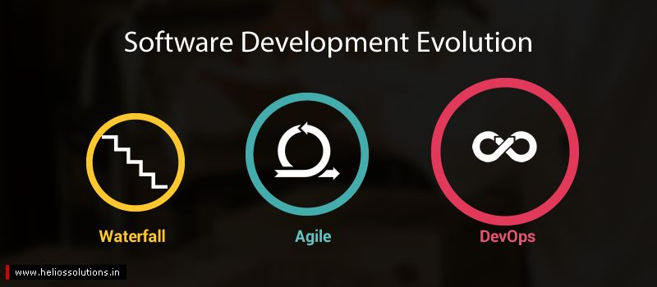

Slide 3
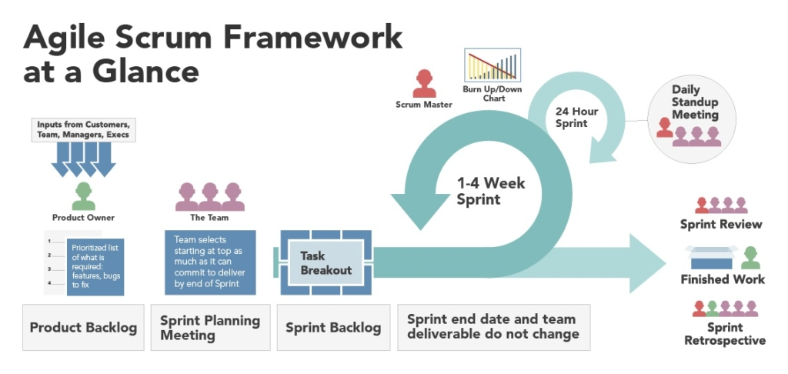

Slide 4
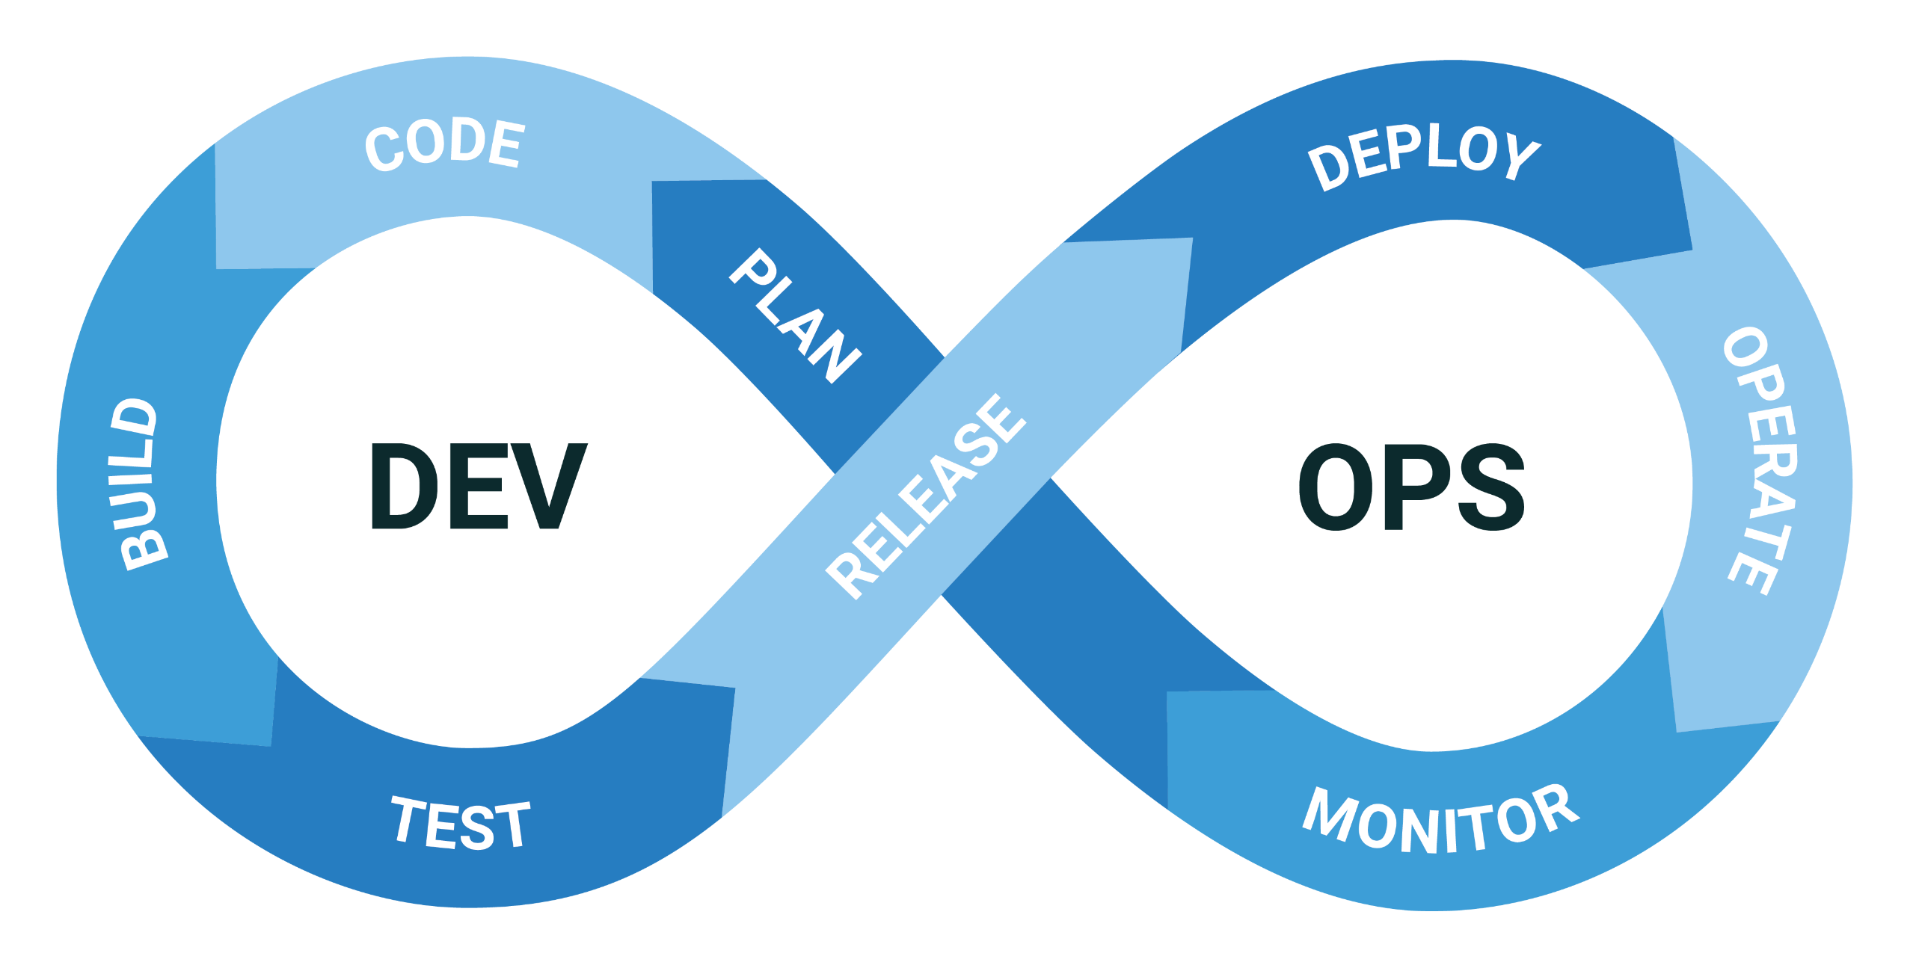

Slide 5
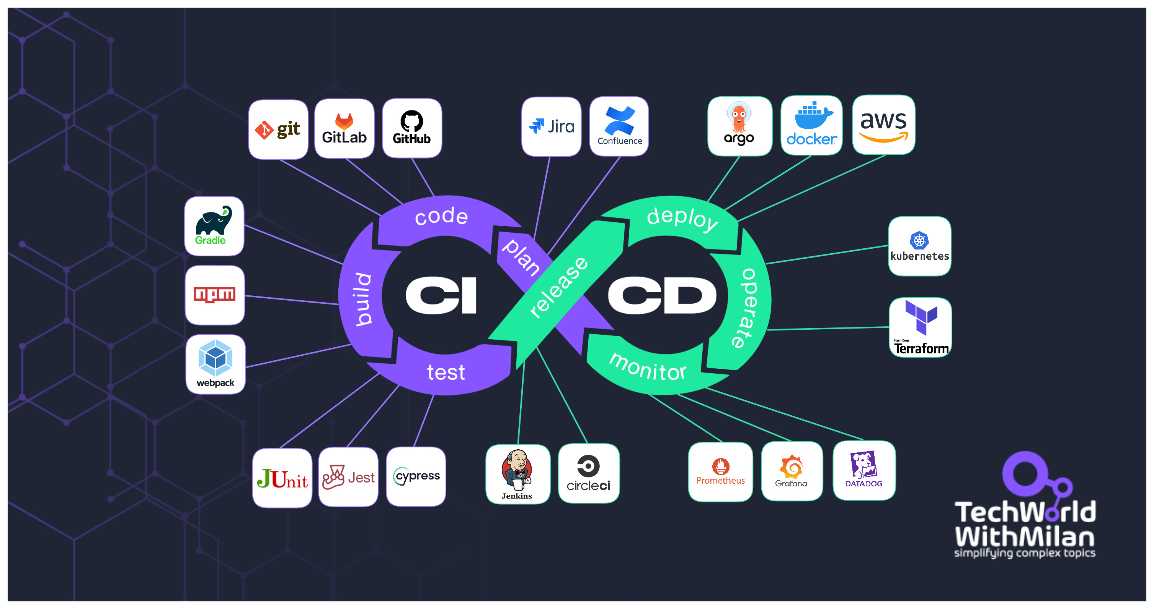

Slide 6
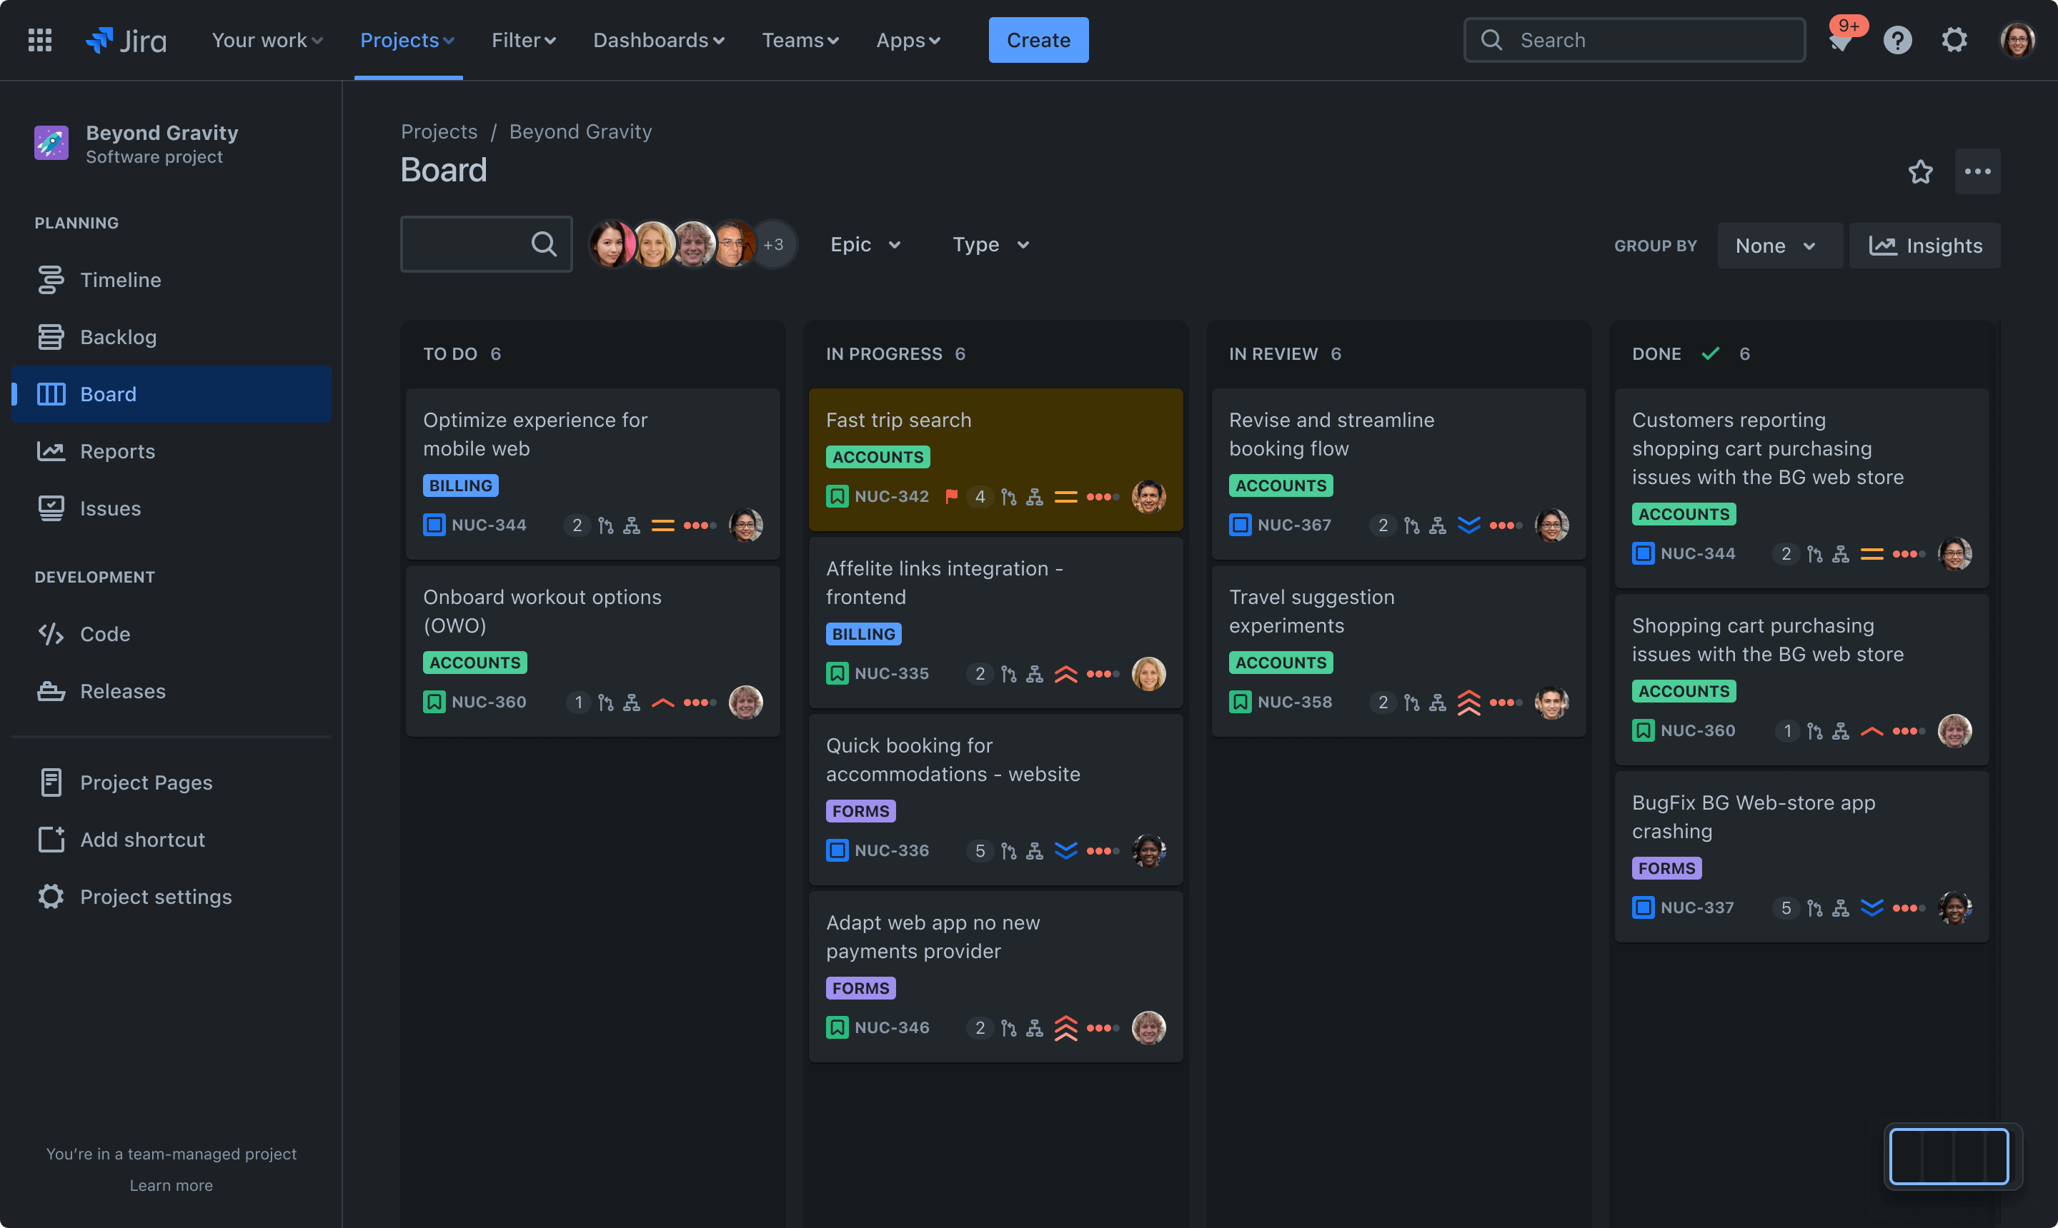
Plan
Code
Build
Test
Release
Deploy
Operate
Monitor
Atlassian Jira (Kanban, Scrum)

Slide 7
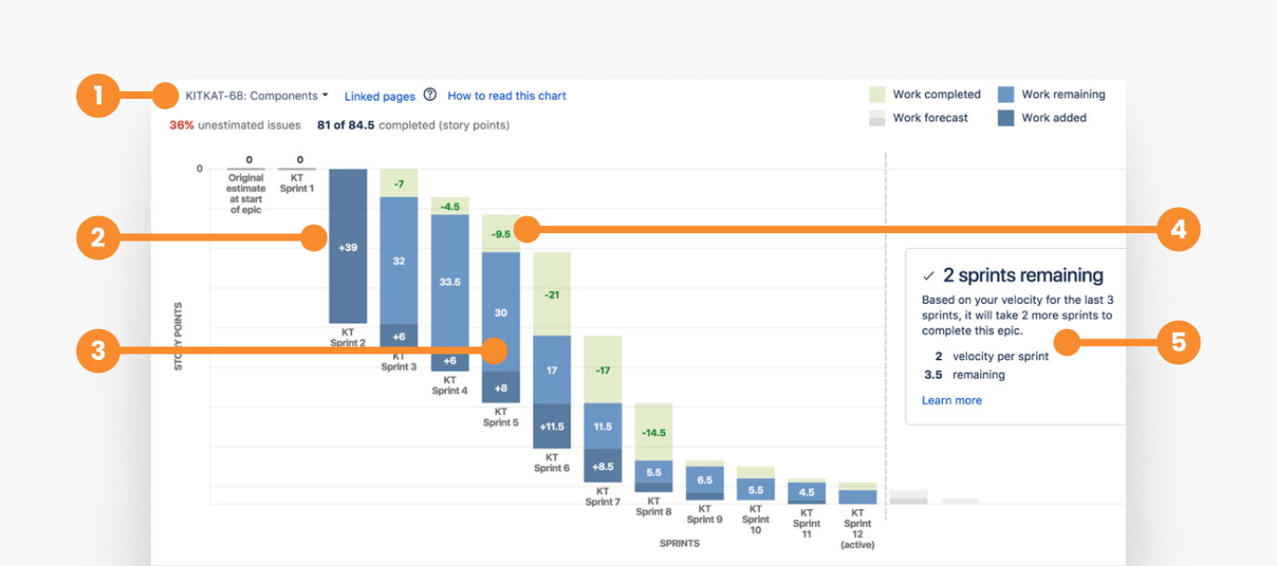
Plan
Code
Build
Test
Release
Deploy
Operate
Monitor
Burndown Chart

Slide 8
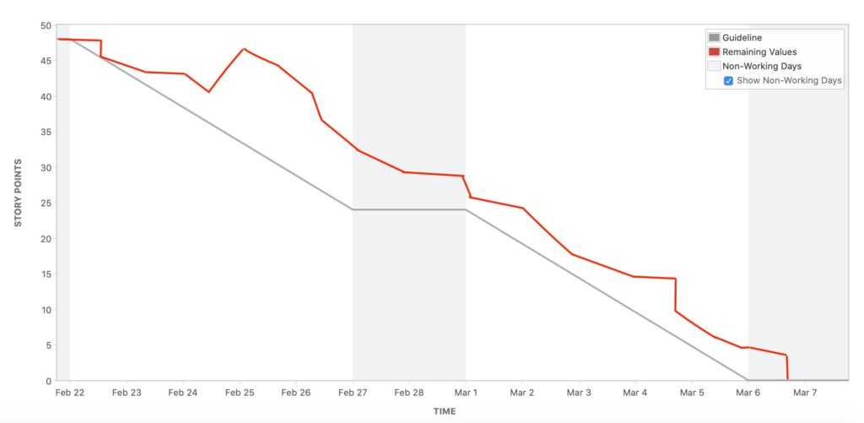
Plan
Code
Build
Test
Release
Deploy
Operate
Monitor
Burndown Chart

Slide 9




Plan
Code
Build
Test
Release
Deploy
Operate
Monitor
GitHub
Gitlab
Bitbucket
Gitea
Git Hosting | Open source | Self Host | Free Private Repo | UI/UX
GitHub | No | No | No | ★★★
Bitbucket | No | Yes (Hard) | Yes | ★
Gitlab | Yes | Yes (Hard) | Yes | ★
Gitea | Yes | Yes (Easy) | Yes | ★★★

Slide 10
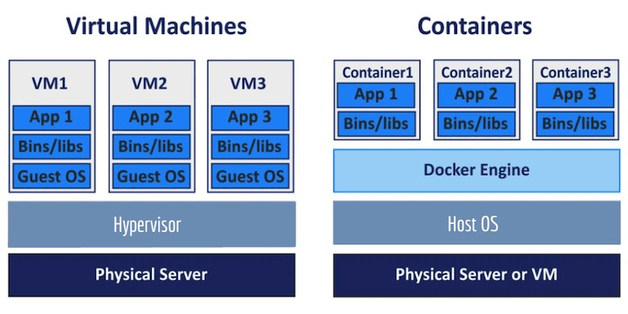
Plan
Code
Build
Test
Release
Deploy
Operate
Monitor

Slide 11
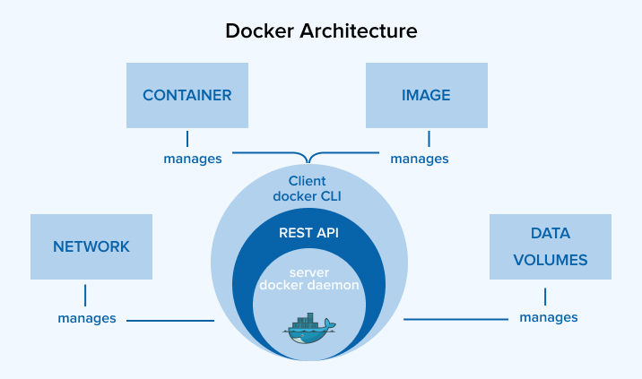
Plan
Code
Build
Test
Release
Deploy
Operate
Monitor
docker images
docker pull
docker ps
docker network
docker volume

Slide 12
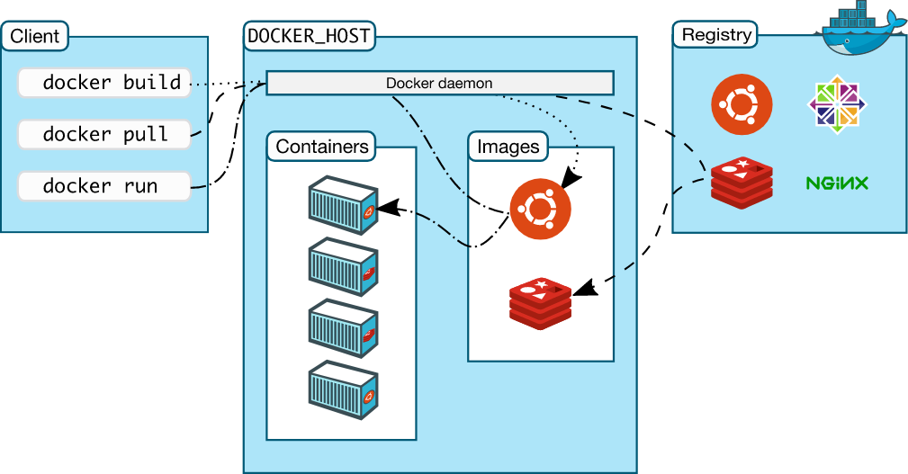
Plan
Code
Build
Test
Release
Deploy
Operate
Monitor
Docker CLI
Docker Host
Docker Registry

Slide 13









Plan
Code
Build
Test
Release
Deploy
Operate
Monitor
02
04
03
Browser Test
Code Quality Test
05
01
Integration Test
Performance Test
Unit Test

Slide 14
Plan
Code
Build
Test
Release
Deploy
Operate
Monitor
Artifactory Type
Binary
Package
Docker Image
Artifactory Storage Type
GitHub Registry
NPM Registry
Docker Registry

Slide 15
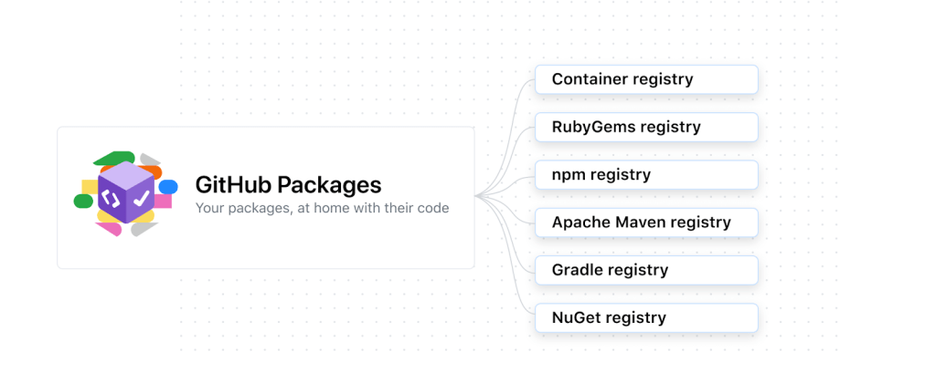
Plan
Code
Build
Test
Release
Deploy
Operate
Monitor

Slide 16
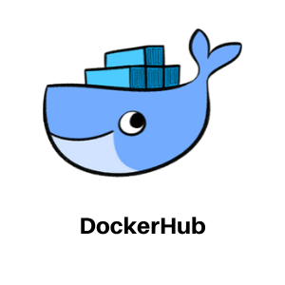
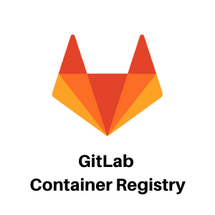
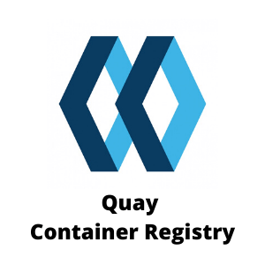


Plan
Code
Build
Test
Release
Deploy
Operate
Monitor

Slide 17
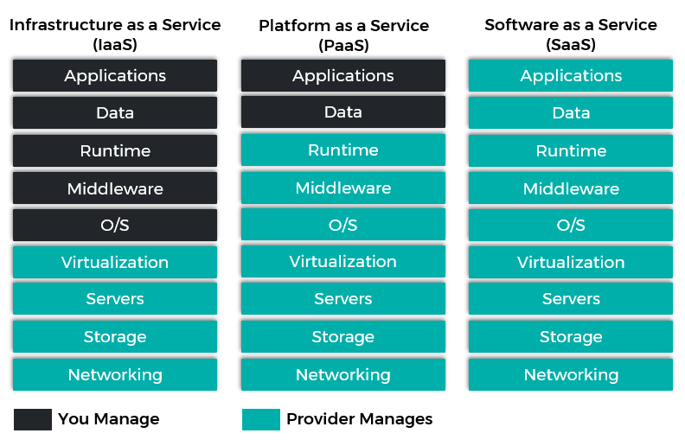
Plan
Code
Build
Test
Release
Deploy
Operate
Monitor

Slide 18
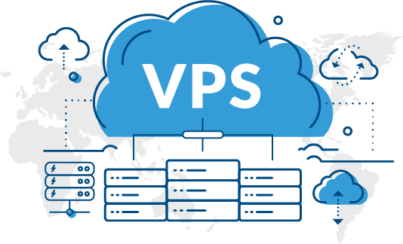

Plan
Code
Build
Test
Release
Deploy
Operate
Monitor

Slide 19
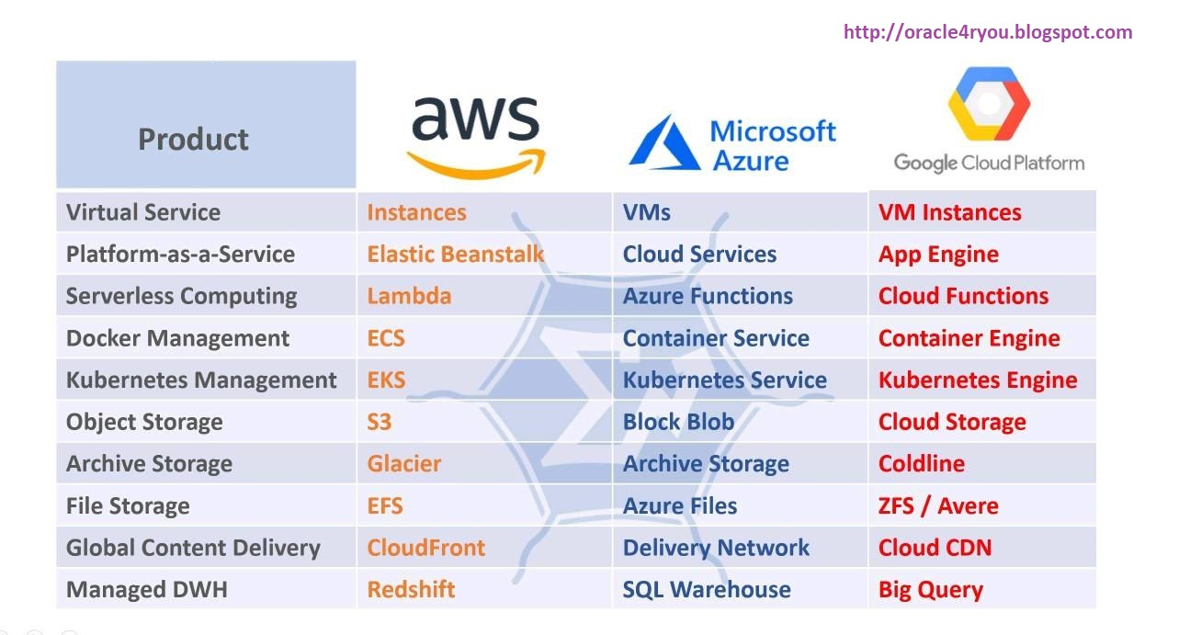
Plan
Code
Build
Test
Release
Deploy
Operate
Monitor

Slide 20

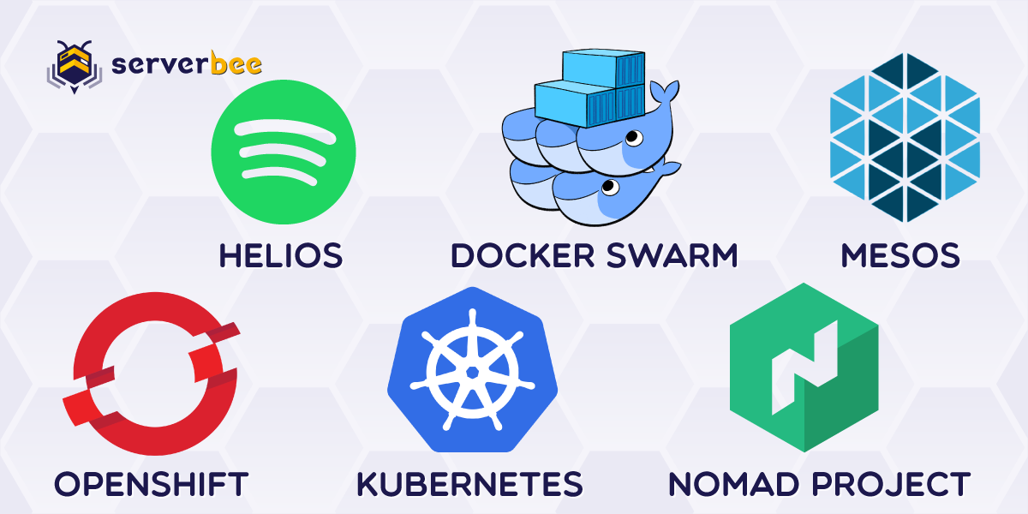
Plan
Code
Build
Test
Release
Deploy
Operate
Monitor
Docker Container Clustering and Orchestration

Slide 21
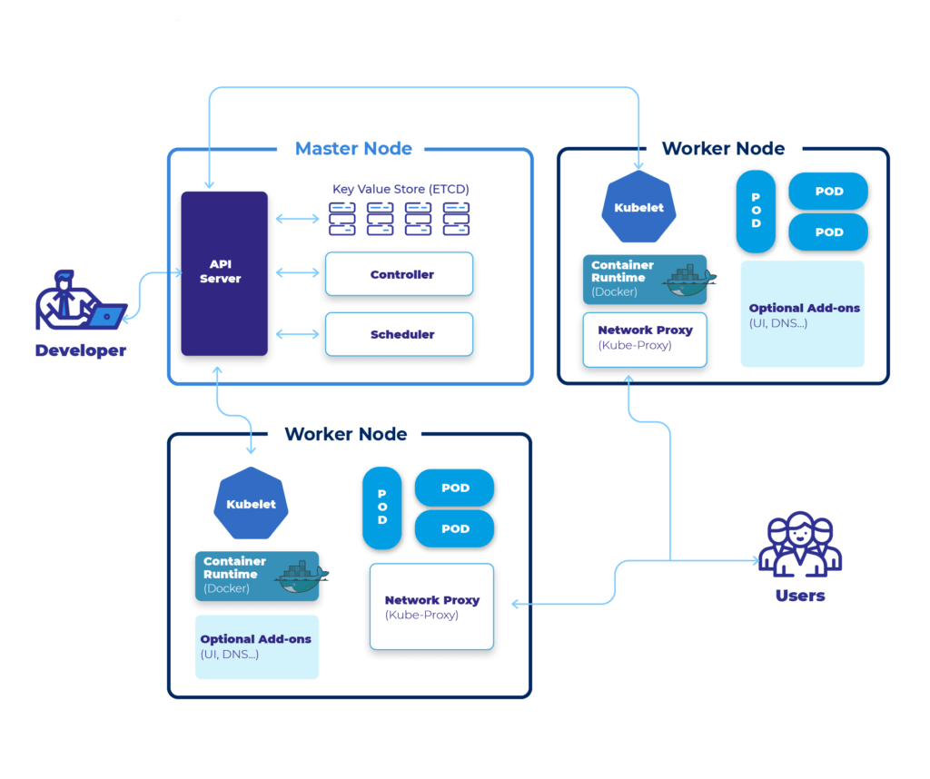
Plan
Code
Build
Test
Release
Deploy
Operate
Monitor

Slide 22
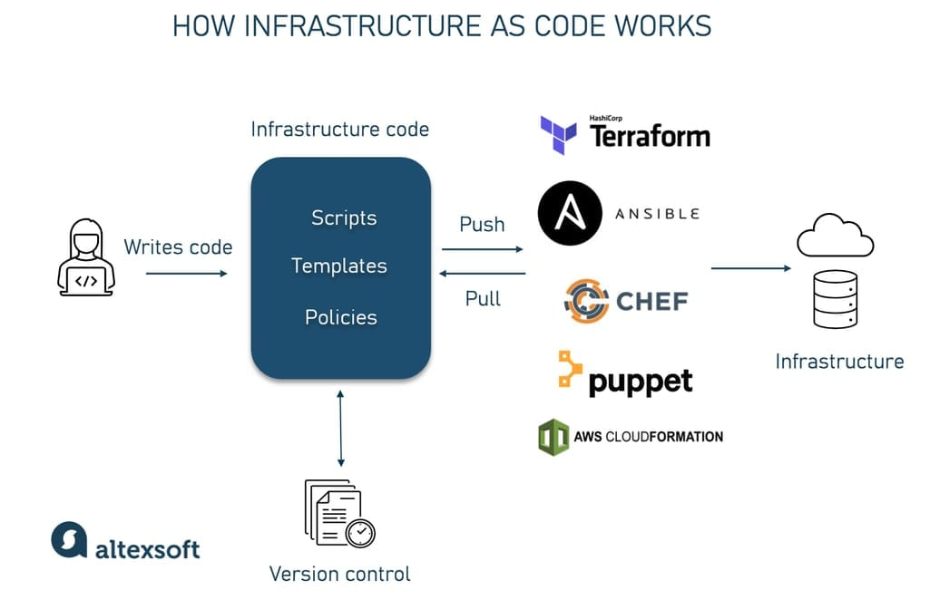
Plan
Code
Build
Test
Release
Deploy
Operate
Monitor
GitOps

Slide 23
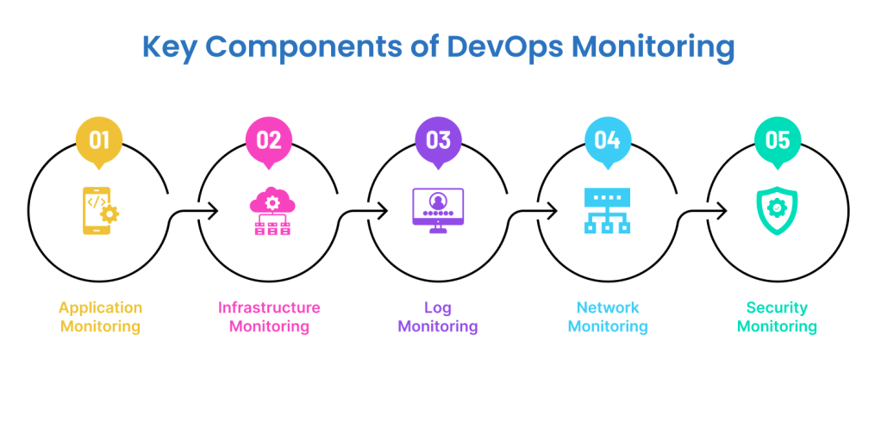
Plan
Code
Build
Test
Release
Deploy
Operate
Monitor

Slide 24
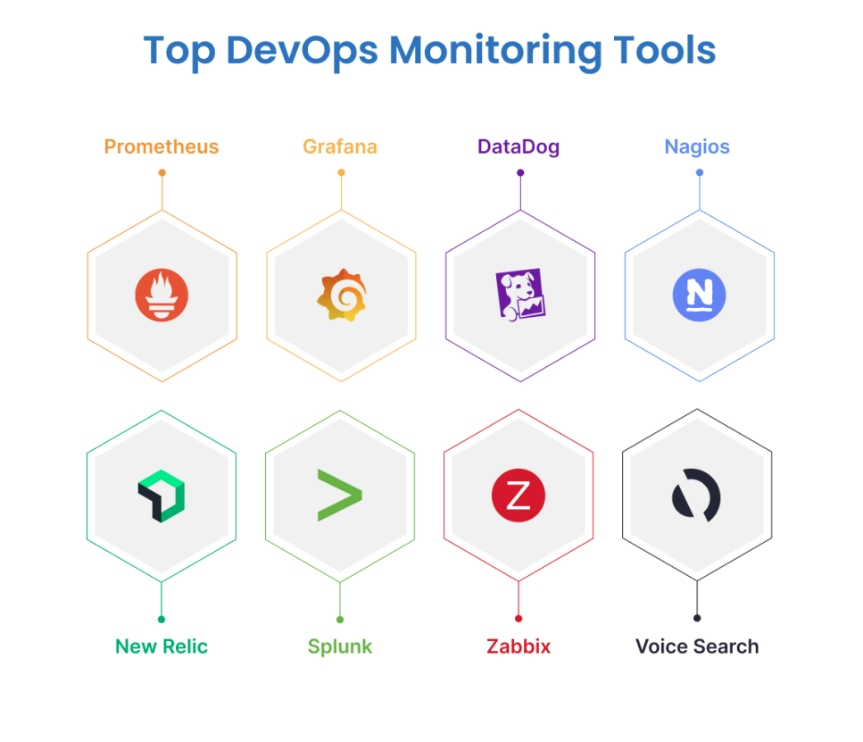
Plan
Code
Build
Test
Release
Deploy
Operate
Monitor

Slide 25
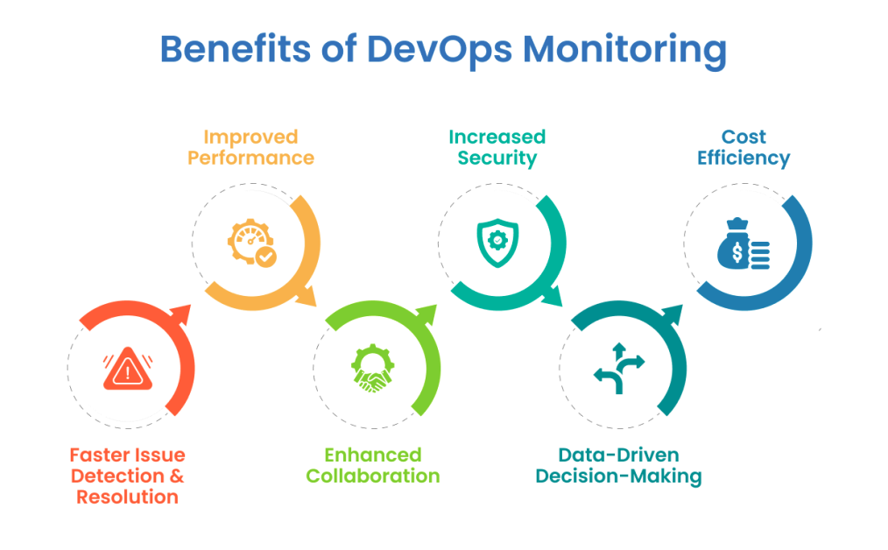
Plan
Code
Build
Test
Release
Deploy
Operate
Monitor

Slide 26
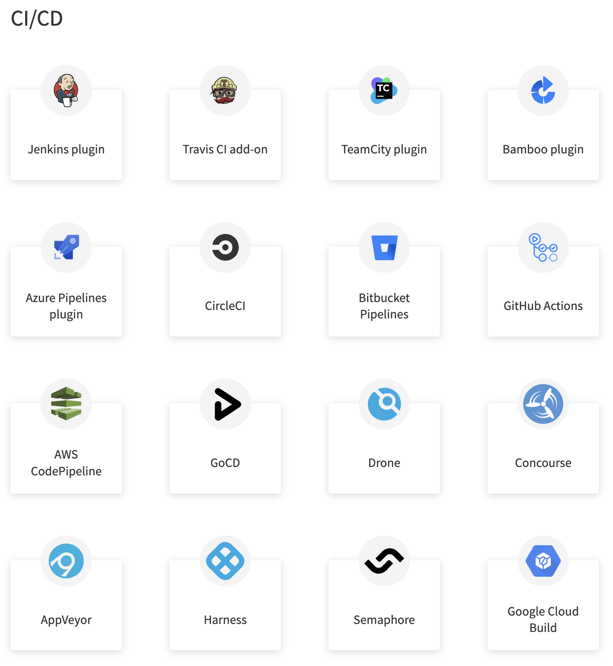

Slide 27
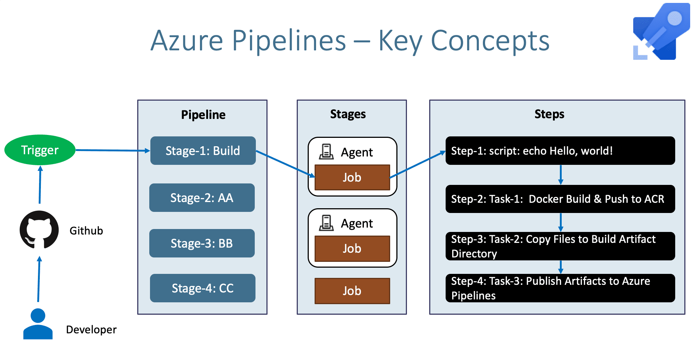

Slide 28
CI/CD Runner Type
Exec Runner
Docker Runner
SSH Runner

Slide 29
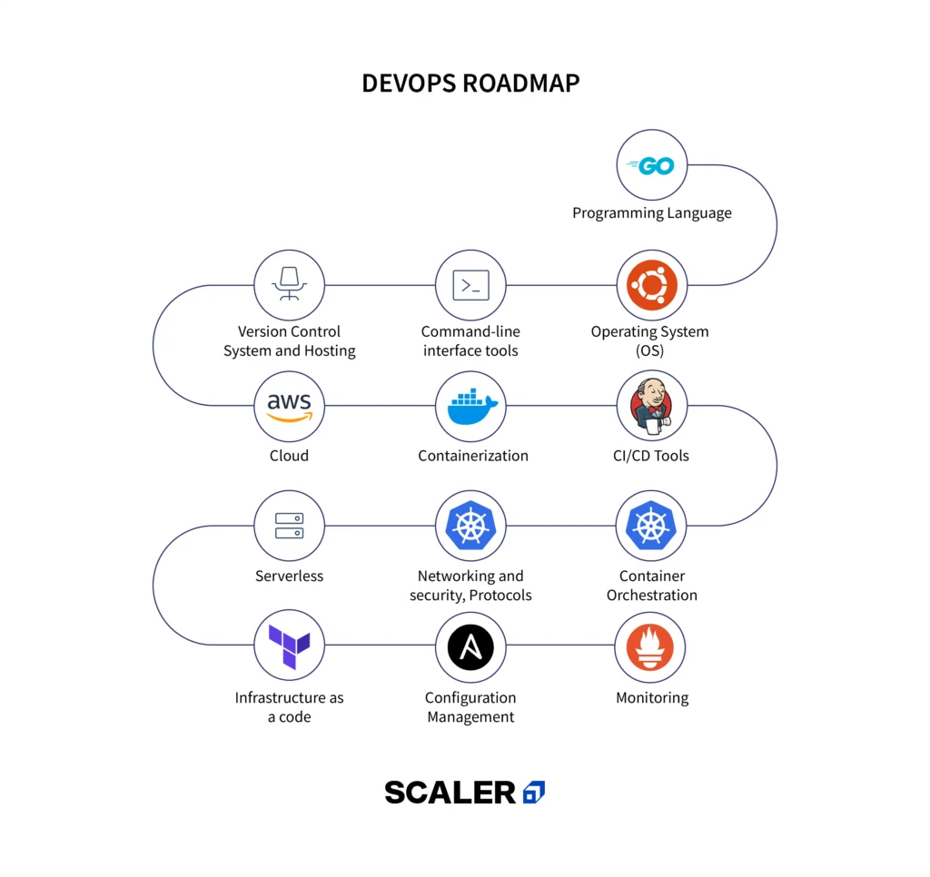

Slide 30
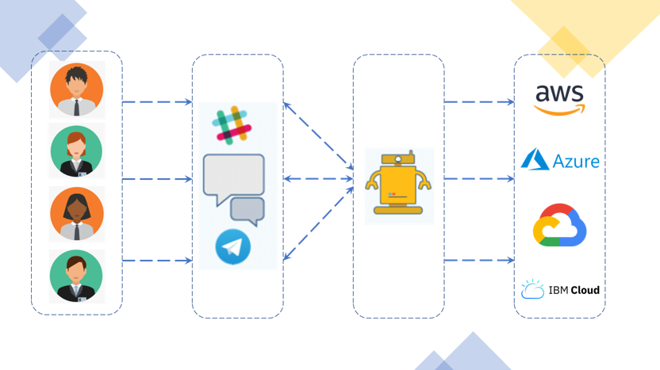
Plan
Code
Build
Test
Release
Deploy
Operate
Monitor
ChatOps

Slide 31
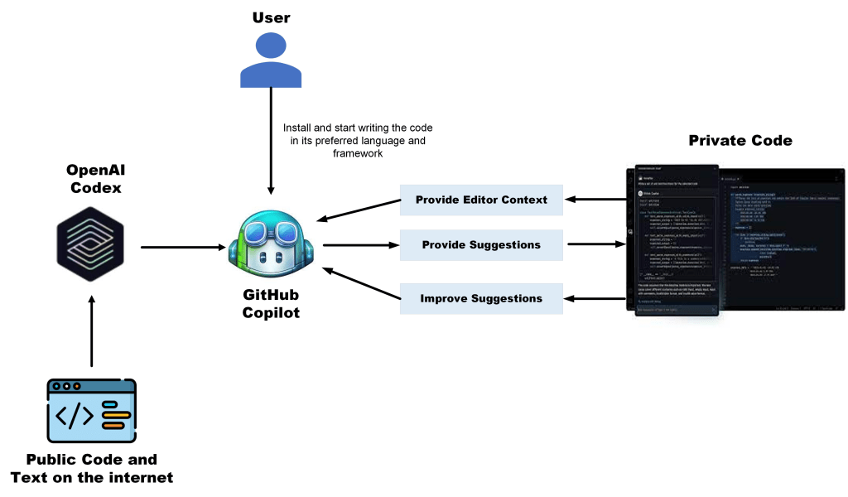
Plan
Code
Build
Test
Release
Deploy
Operate
Monitor

Slide 32
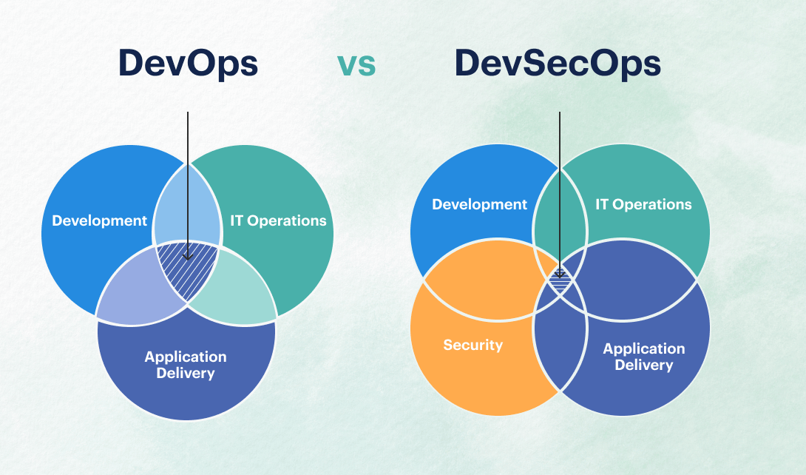

Plan
Code
Build
Test
Release
Deploy
Operate
Monitor
GitHub DependaBot

